Slide 1
Introduction to Statistical Method

Slide 2
Course No: DSECL ZC413 Course Title: ISM WEBINAR 3

Slide 3
Topics – Webinar
Normal Distribution
Null and Alternative Hypothesis
Testing of Hypothesis ( z- test and t test )
Chi-Square test

Slide 4
Test of Hypothesis small samples Single mean Example 1
9. A spectrophotometer used for measuring CO concentration [ppm (parts per million) by volume] is checked for accuracy by taking readings on a manufactured gas (called span gas) in which the CO concentration is very precisely controlled at 70 ppm. If the readings suggest that the spectrophotometer is not working properly, it will have to be recalibrated. Assume that if it is properly calibrated, measured concentration for span gas samples is normally distributed. On the basis of the six readings—85, 77, 82, 68, 72, and 69—is recalibration necessary?

Slide 5
Test of Hypothesis small samples Single mean
Solution 1

Slide 6
Test of Hypothesis small samples Single mean
Solution 1

Slide 7
Test of Hypothesis small samples two mean
Example-1
10. The article “Effect of Internal Gas Pressure on the Compression Strength of Beverage Cans and Plastic Bottles” (J. of Testing and Evaluation, 1993: 129–131) includes the accompanying data on compression strength (lb) for a sample of 15-oz aluminium cans filled with strawberry drink and another sample filled with cola.
Does the data suggest that the extra carbonation of cola results in a higher average compression strength?
 | sample size | sample mean | sample SD
Strawberry drink | 15 | 540 | 21
Cola | 15 | 554 | 15

Slide 8
Test of Hypothesis small samples two mean
Solution 1

Slide 9
Test of Hypothesis small samples two mean
Solution 1

Slide 10
Test of Hypothesis small samples two mean
Example-2
11. Validate the hypothesis that product A is superior to product B in terms of performance. A sample of 20 items of product A is having mean life of 12 months with standard deviation 15 days where as product B is having mean life of 10 months with standard deviation 10 days. Use p – value and validate the hypothesis.

Slide 11
Test of Hypothesis small samples two mean
Solution .2

Slide 12
Test of Hypothesis small samples two mean
Solution .2

Slide 13
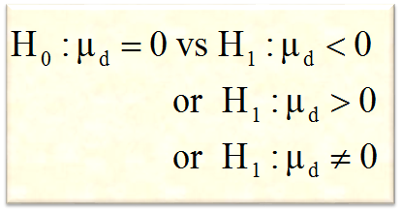
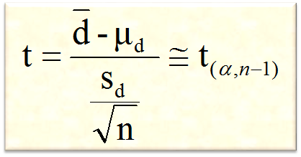
Testing the difference between means of paired observations
1
State null and alternative hypothesis
2
Specify the level of significance ‘α’
3
Student’s t-distribution
4
Compute the test statistic
5
Define the critical region/ rejection criteria
But µ_{d} under H₀ will be 0
6
Conclusion
Note: Rejection criteria may be based on critical value or P-value

Slide 14
Example-1
Testing the difference between means of paired observations
12. The HRD manager wishes to see if there has been any change in the ability of trainees after a specific training program. The trainees take a aptitude test before and after training program.
Test at 5% level of significance is there any difference in the test score after training
Subjects | Before (x) | After (y)
1 | 75 | 70
2 | 70 | 77
3 | 46 | 57
4 | 68 | 60
5 | 68 | 79
6 | 43 | 64
7 | 55 | 55
8 | 68 | 77
9 | 77 | 76

Slide 15
Solution : 1
Testing the difference between means of paired observations

Slide 16
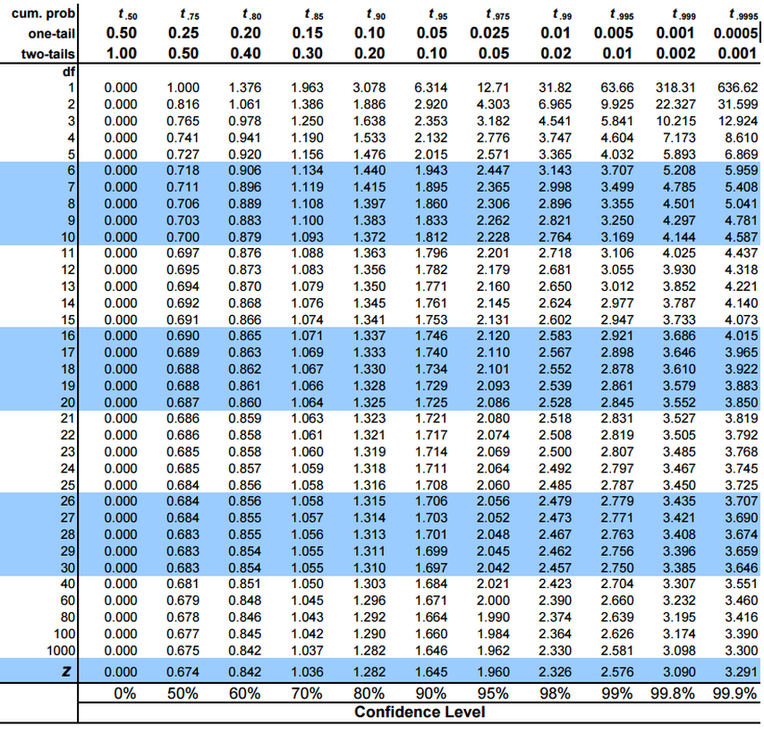
Testing the mean of a single population

Slide 17
Large Samples (Single proportion)
If Population proportion is known then
Test Statistic:

Slide 18
Example-1 Single proportion
Test of Hypothesis single proportion
13. A random sample of 150 recent donations at a certain blood
bank reveals that 82 were type A blood. Does this suggest
that the actual percentage of type A donations differs from
40%, the percentage of the population having type A blood?
Carry out a test of the appropriate hypotheses using a significance level of .01.

Slide 19
Solution 1
Test of Hypothesis single proportion

Slide 20
Test of Hypothesis single proportion
Solution 1

Slide 21
TEST OF HYPOTHESIS TWO PROPORTIONS LARGE SAMPLE Example-1
14. It is thought that the front cover and the nature of the first question on mail surveys influence the response rate. The article “The Impact of Cover Design and First Questions on Response Rates for a Mail Survey of Skydivers” (Leisure
Sciences, 1991: 67–76) tested this theory by experimenting with different cover designs. One cover was plain; the other used a picture of a skydiver. The researchers speculated that the return rate would be lower for the plain cover.
Does this data support the researchers’ hypothesis?
Cover | Number Sent | Number Returned
Plain | 207 | 104
Skydiver | 213 | 109

Slide 22
Solution 1
TEST OF HYPOTHESIS TWO PROPORTIONS LARGE SAMPLE

Slide 23
TEST OF HYPOTHESIS TWO PROPORTIONS LARGE SAMPLE Solution 1

Slide 24
Chi-square test
An example of a 2 x 2 contingency table
O_{i}’s are called observed frequency.
Categorical Variable 1 | Categorical variable 2 |  | Total
 | Response 1 | Response 2
Response 1 | O₁ | O₂ | r₁
Response 2 | O₃ | O₄ | r₂
Total | c₁ | c₂ | n

Slide 25
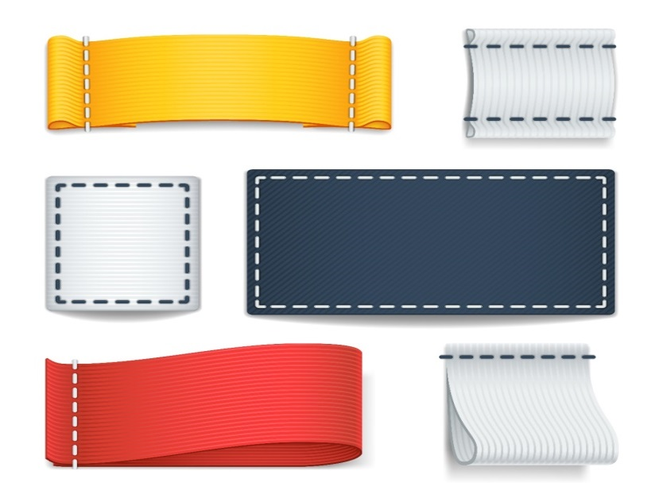
Chi-square test
2 x 2 Contingency Table for testing independence
Categorical Variable 1 | Categorical variable 2 |  | Total
 | Present | Absent
Present | O₁ E₁ | O₂ E₂ | r₁
Absent | O₃ E₃ | O₄ E₄ | r₂
Total | c₁ | c₂ | n
Calculation
of expected
frequencies

Slide 26
Chi-square test
Hypothesis for testing independence
The hypothesis to be tested for independence will be
H₀: The two categorical variables may be
independent (may not be associated)
Observed = Expected
H₁: The two categorical variables may not be
independent (may be associated)
Observed ≠ Expected

Slide 27
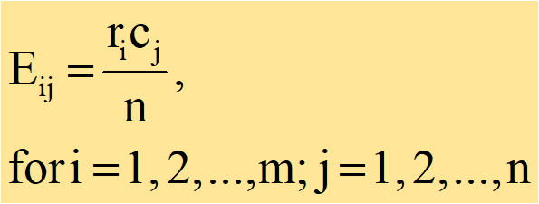
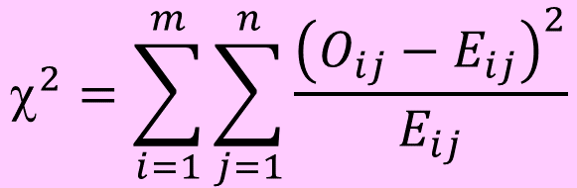
Chi-square test
Procedure for testing independence
To check the independence (no association) between the two categorical variables, the statistical test used is Chi-square test given by
$${\text{}}^{2}=\sum_{i=1}^{m}{\sum_{j=1}^{n}{\frac{{\left(O_{ij}−E_{ij}\right)}^{2}}{E_{ij}}}}$$
The test-statistic follows Chi-square distribution with
(r-1)(c-1) degrees of freedom. r = no. of rows, c = no. of columns

Slide 28
Chi-square test : Example -1
15. 1000 students at college level were graded according to their I.Q. and the economic conditions at their home. Find out whether there is any association between condition at home and I.Q. (use 0.05 L.O.S.)
Economic Condition | High | Low | Total
Rich | 460 | 140 | 600
Poor | 240 | 160 | 400
Total | 700 | 300 | 1000

Slide 29
Chi-square test : Solution-1

Slide 30
Chi-square test : Solution-1

Slide 31
Chi-square test : Solution-1

Slide 32
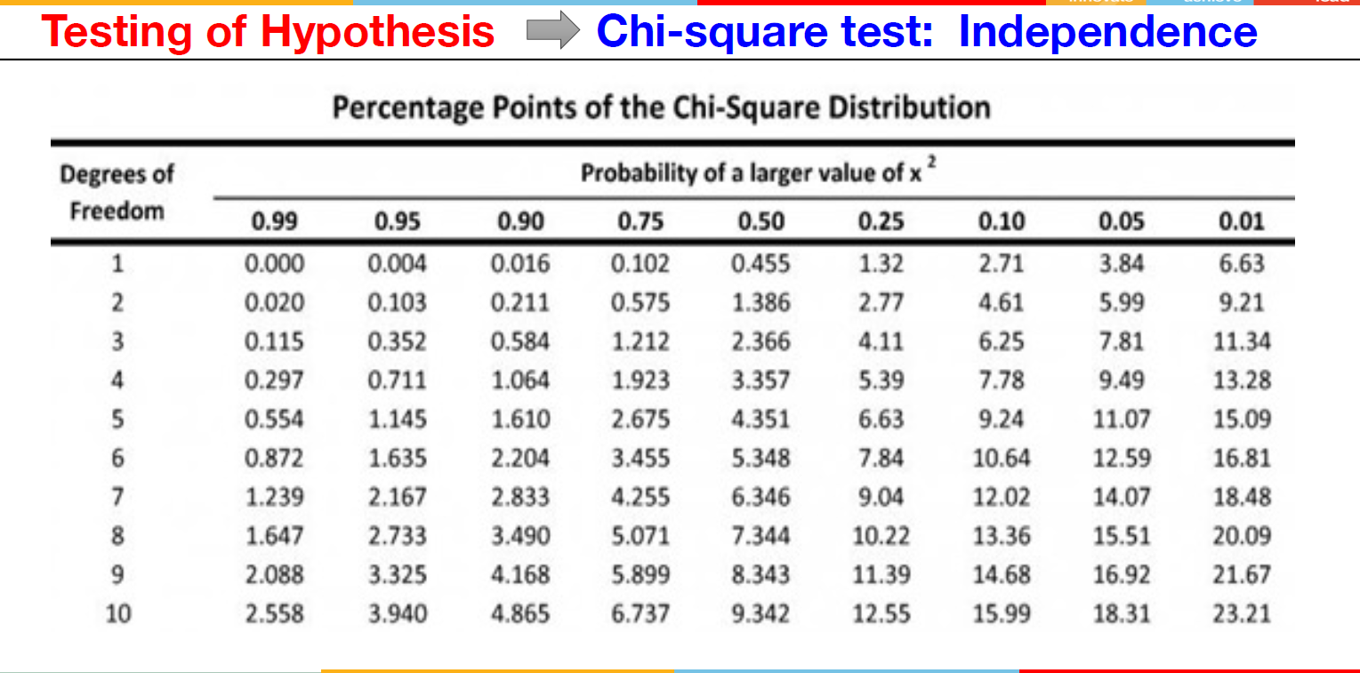
Chi-square test

Slide 33
Chi-square test : Example
An RTO department has observed that on an highway more number of accidents have taken place in the early hours of the day than other timings and wish to associate the outcome of the accidents with timings. A survey findings shows that, of the 400 accident cases studied, 280 had met with accident in the early hours and 99 of them were fatal. Further, those who met with accident in the early hours and died was 80.
Does this data indicate any association between the time of accident and fatality of the accident. Use α = 0.05.

Slide 34
Chi-square test
Hypothesis
H₀: Timings of accident and its outcome are independent
(Not associated)
H₁: Timings of accident and its outcome are independent
(Associated)

Slide 35
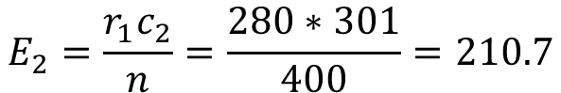
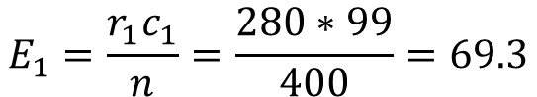
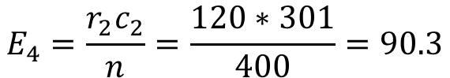
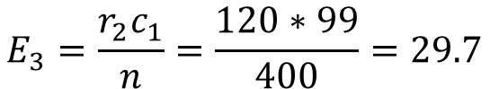
Chi-square test
Early hours of accident | Outcome of accident |  | Total
 | Fatal | Non-fatal
Yes | 80 | 200 | 280
No | 19 | 101 | 120
Total | 99 | 301 | 400
$$E_{1}=\frac{r_{1}c_{1}}{n}=\frac{280∗99}{400}=69.3$$
$$E_{3}=\frac{r_{2}c_{1}}{n}=\frac{120∗99}{400}=29.7$$
$$E_{2}=\frac{r_{1}c_{2}}{n}=\frac{280∗301}{400}=210.7$$
$$E_{4}=\frac{r_{2}c_{2}}{n}=\frac{120∗301}{400}=90.3$$

Slide 36
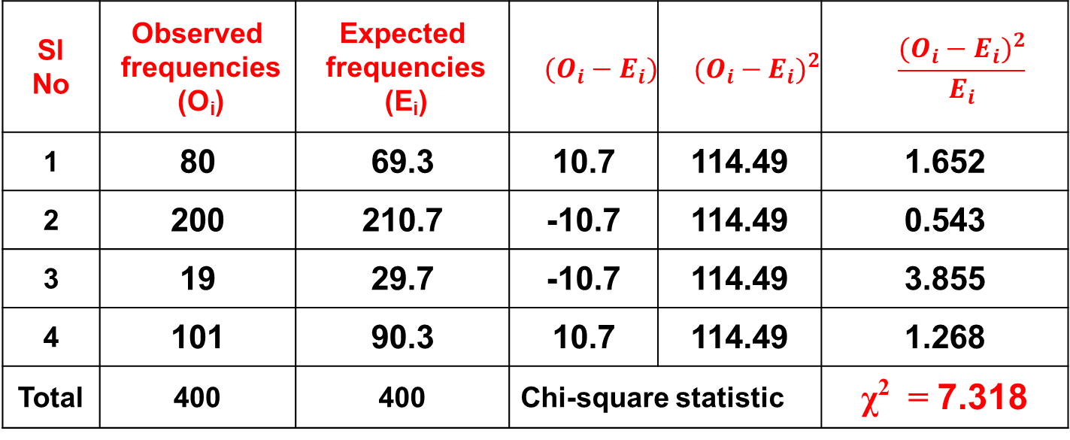
Chi-square test
Calculation of Chi-square statistic - χ2
Sl No | Observed frequencies (O_{i}) | Expected frequencies (E_{i}) | $$(O_{i}−E_{i})$$ | $${(O_{i}−E_{i})}^{2}$$ | $$\frac{{(O_{i}−E_{i})}^{2}}{E_{i}}$$
1 | 80 | 69.3 | 10.7 | 114.49 | 1.652
2 | 200 | 210.7 | -10.7 | 114.49 | 0.543
3 | 19 | 29.7 | -10.7 | 114.49 | 3.855
4 | 101 | 90.3 | 10.7 | 114.49 | 1.268
Total | 400 | 400 | Chi-square statistic |  | χ² = 7.318

Slide 37
Chi-square test
Hypothesis
H₀: Timings of accident and its outcome are independent
(Not associated)
H₁: Timings of accident and its outcome are dependent
(Associated)
χ²= 7.31
df = 1,
Critical value at α = 0.05 is 3.841,
Inference: There may be an association between
timings of accident and its outcome

